Slide 1
Year 9 RE
Ethical Issues Revision Pack
Unit 1. Issues of Relationships
Unit 2. Issues of Life and Death
Unit 3. Issues of Good and Evil
Exam Technique
Question Type: | What the question is asking:
a) | What is meant by…
b) | Describe…
c) | Explain, from two religions or two religious traditions, beliefs about…
d) | [Statement] Discuss this statement showing you have considered more than one point of view (You must refer to religious and non-religious beliefs in your answer).
How to answer each question:
a) A detailed definition OR a simple definition and a relevant example
b) Five relevant, different points Each point should not be general: it must be religion specific
c) Two different religions or denominations Structure: Point Evidence Explanation Link back to the Question x2 Explain how a teaching influences a believer
d) Explain two religious and one non-religious response to the statement -Structure: Point Evidence Explanation Link Judgement -You must evaluate each response and reach a judgement on which is the strongest!

Slide 2

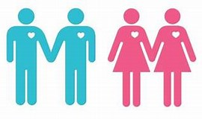
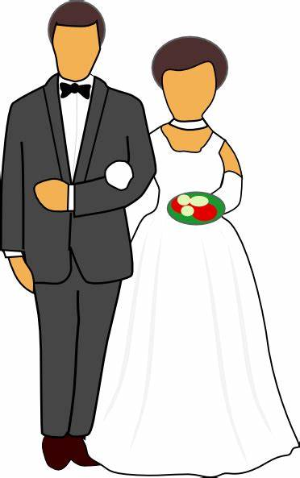
1.Issues of Relationships
Keywords
Stereotype- a widely held but oversimplified view of a particular type of person or thing, not necessarily based on truth. E.g. All women are bad drivers
Prejudice- to pre-judge a person or group of people before you know them based on characteristics like race, gender, sexuality or religion. E.g. believing that someone is a terrorist because they are Muslim
Discrimination- Acting on a prejudice. To treat a person or a group of people differently because of a characteristic like race, gender, sexuality or religion. E.g. not employing someone because they are homosexual
Arranged marriage-
A marriage where the bride and groom are selected by their families with the agreement of all involved.
The Role of the Family for Religious Believers
Christian Bible says: ‘Fathers, do not provoke your children to anger, but bring them up in the discipline and instruction of the Lord.’ (Christians should have children and bring them up in the Christian faith, following the example of God/Jesus. 2. Parents have a duty to love and care for their children by providing a loving environment as well as a duty of teaching them right from wrong.
Muslim Qu’ran says: ‘A man is the guardian of his family and he is responsible for them. A woman is the guardian of her husband’s home and his children and she is responsible for them.’ (Muslims believe it is their duty to get married and have children. 2. Parents should love, care and provide for their children, teaching them to follow Muslim teachings and practices.)
Religious Attitudes to Same-Sex Relationships
Christians For-
The Bible was written thousands of years ago and needs to be interpreted in light of the social and cultural norms of 2021
Jesus taught everyone to love and treat others equally: ‘Treat people how you would want to be treated’ and ‘Love your neighbour’
The Church of England now allows gay priests to lead the church; the Quaker Church accepts same-sex marriage
Christians Against-
If God had wanted Adam to be with a man, he would have created him a male companion instead of Eve.
The purpose of sex is for procreation (having children). Therefore, same sex relationships go against God’s plan for us to ‘go forth and multiply’ (have children).
The Bible states: ‘Man should not lie with a man as he does with a woman’ . Therefore, it would be wrong for a man to have sex with another man.
Homosexuality is considered sexual immorality, and therefore a sin. The Bible tells Christians to ‘flee from sexual immorality’.
Muslims Against-
The Qur’an states that those who ‘lust after men instead of women’ are a ‘degenerate people’.
The Hadith describes lesbianism as ‘adultery’ and states that women in same-sex relationships should be put to death.
In many Muslims countries, under the Shari’ah law, homosexuality is punishable by death.
Religious Attitudes to Marriage and Divorce
Christians - Marriage is part of God’s plan for creation
An acceptable place to have sexual relations (although ideal state is celibacy)
Vows made in front of God that amounts to a binding promise / Marriage is a lifetime commitment
Jesus said: ‘I tell you that anyone who divorces his wife, except for marital unfaithfulness, and marries another woman commits adultery.’ / Jesus’s teaching on divorce is that it is adultery, which is forbidden in the Ten Commandments, but he did allow for divorce in the case of a partner’s infidelity. This is interpreted by different denominations in different ways:
Roman Catholics do not recognise divorce and do not allow remarriage unless one partner has died. They will try to resolve problems as divorce is forbidden, but if unable - can have civil divorce but cannot remarry in Catholic Church as the initial marriage was an everlasting covenant
The Church of England does not advocate divorce but it is allowed if the marriage has truly broken down and cannot be repaired. Someone who is divorced can now remarry in an Anglican church.
Muslims -
Marriage is the normal state for adults
Marriage is a contract
The purpose of marriage is to raise children in the Muslim faith
Although it is not encouraged, most Muslims agree that divorce is permitted if a marriage has broken down as long as the wife is not pregnant, and generally Muslims are permitted to remarry if they so wish.
But, the Prophet Mohammed (PBUH) said: “The most detestable of lawful things before Allah is divorce.” / Although divorce is allowed, Muslims must avoid it.
Sunni Muslims do not require witnesses. The husband must express his desire for a divorce on three separate occasions with a waiting period of three months.
Shi'ah Muslims require two witnesses, followed by a waiting period before a marriage can end.

